Slide 1
Multimodal Compact Bilinear Pooling for VQA
From the author’s slides

Slide 2
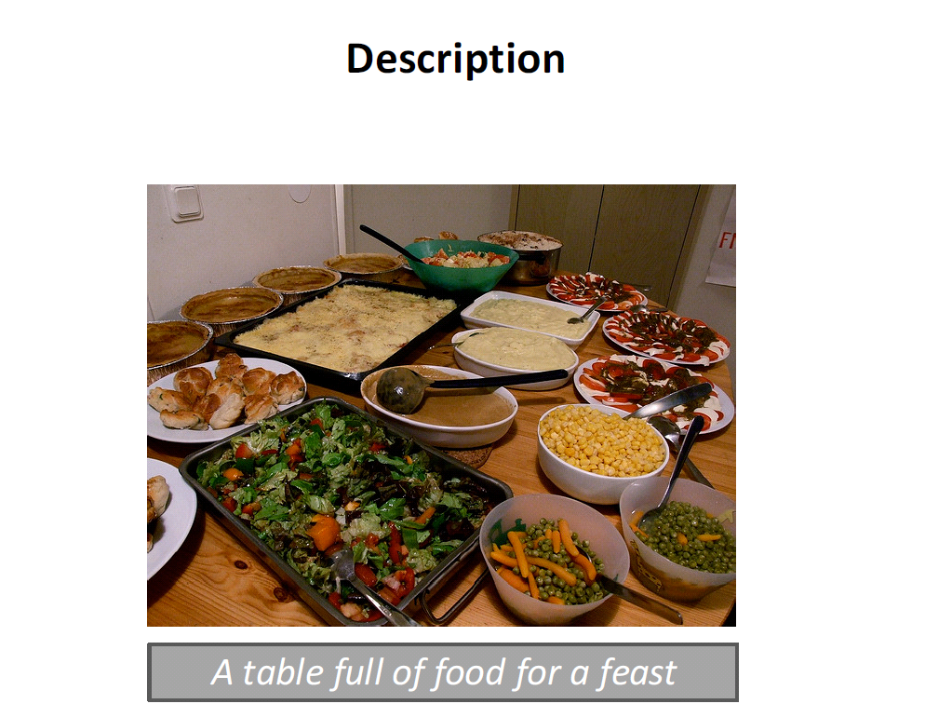
Multimodal language and visual understanding

Slide 3
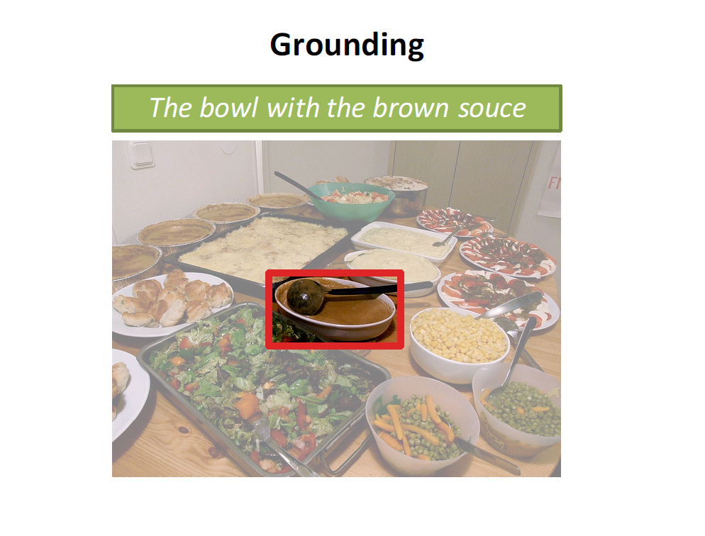
Multimodal language and visual understanding

Slide 4
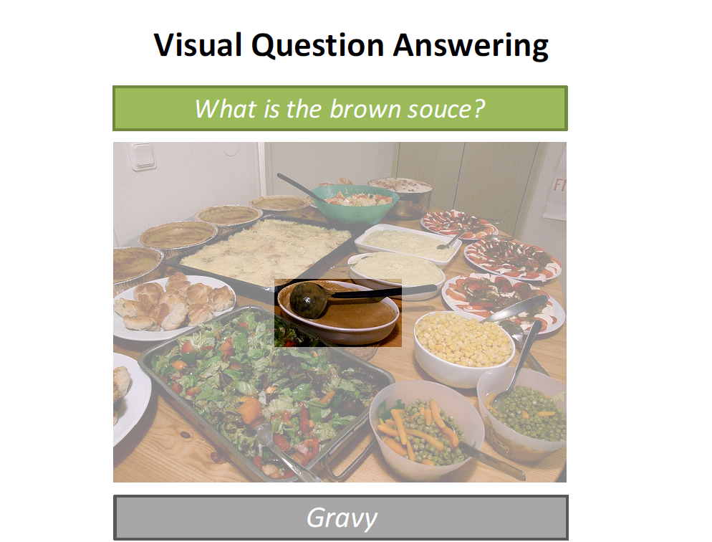
Multimodal language and visual understanding

Slide 5
Multimodal language and visual understanding

Slide 6
Multimodal language and visual understanding

Slide 7
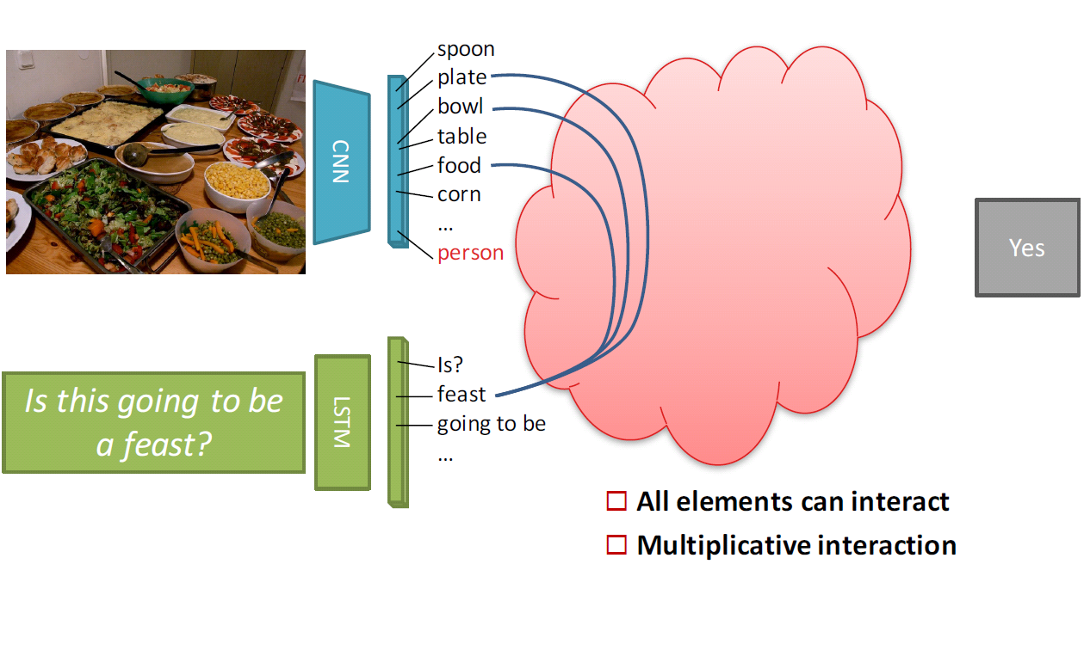
How to combine image and question?

Slide 8
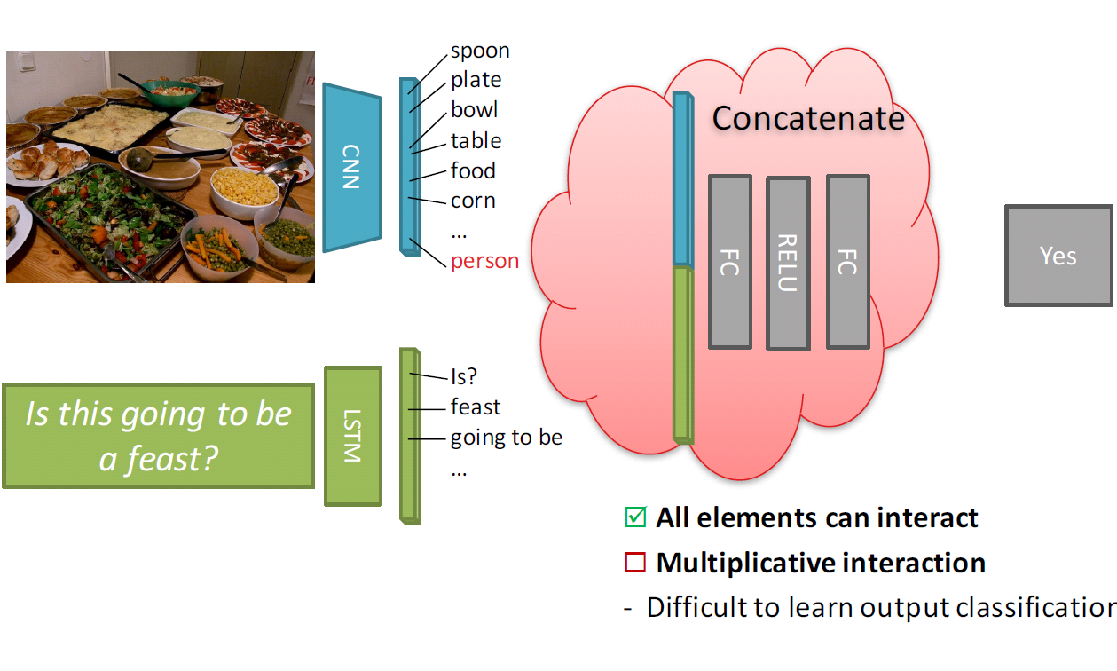
How to combine image and question?

Slide 9
How to combine image and question?

Slide 10
How to combine image and question?

Slide 11
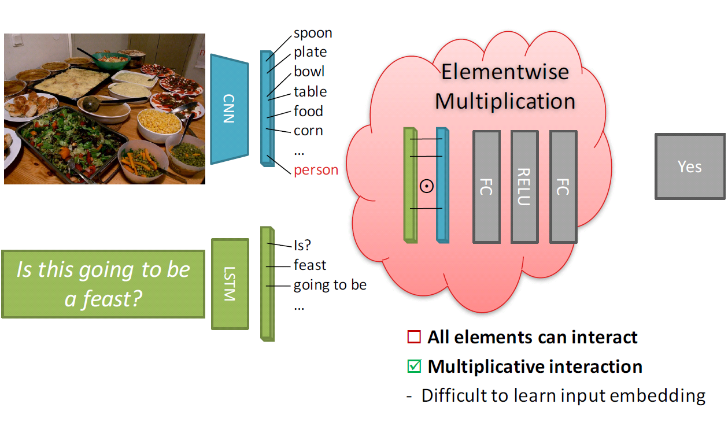
How to combine image and question?

Slide 12
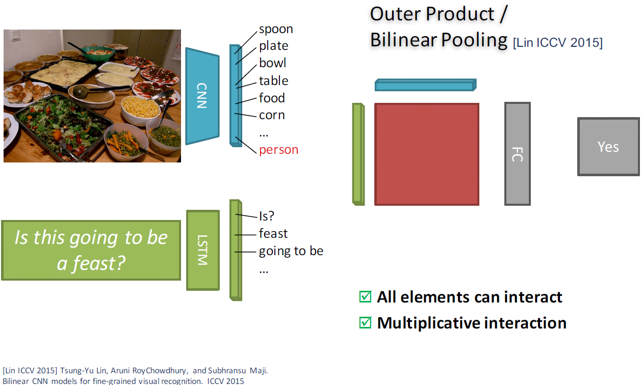
How to combine image and question?

Slide 13
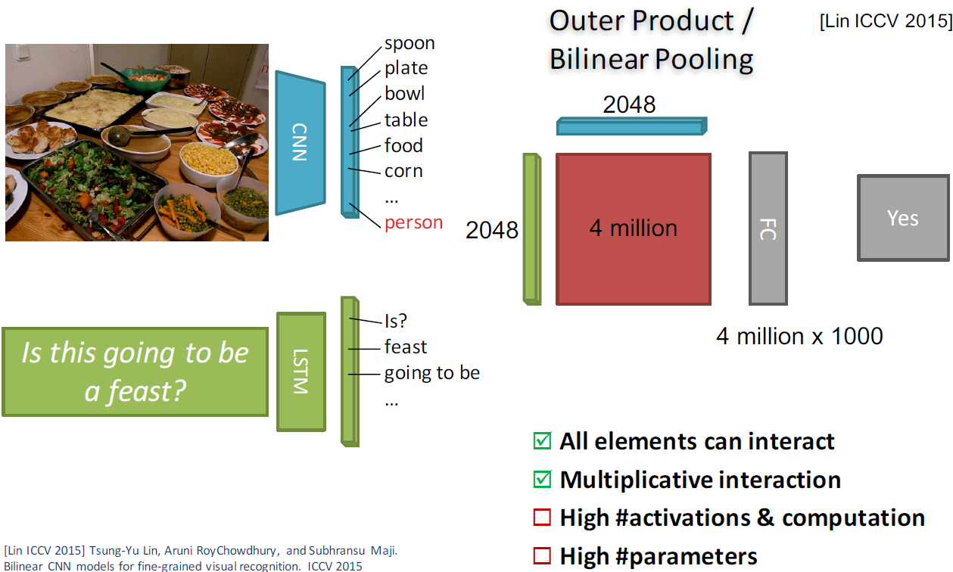
How to combine image and question?

Slide 14
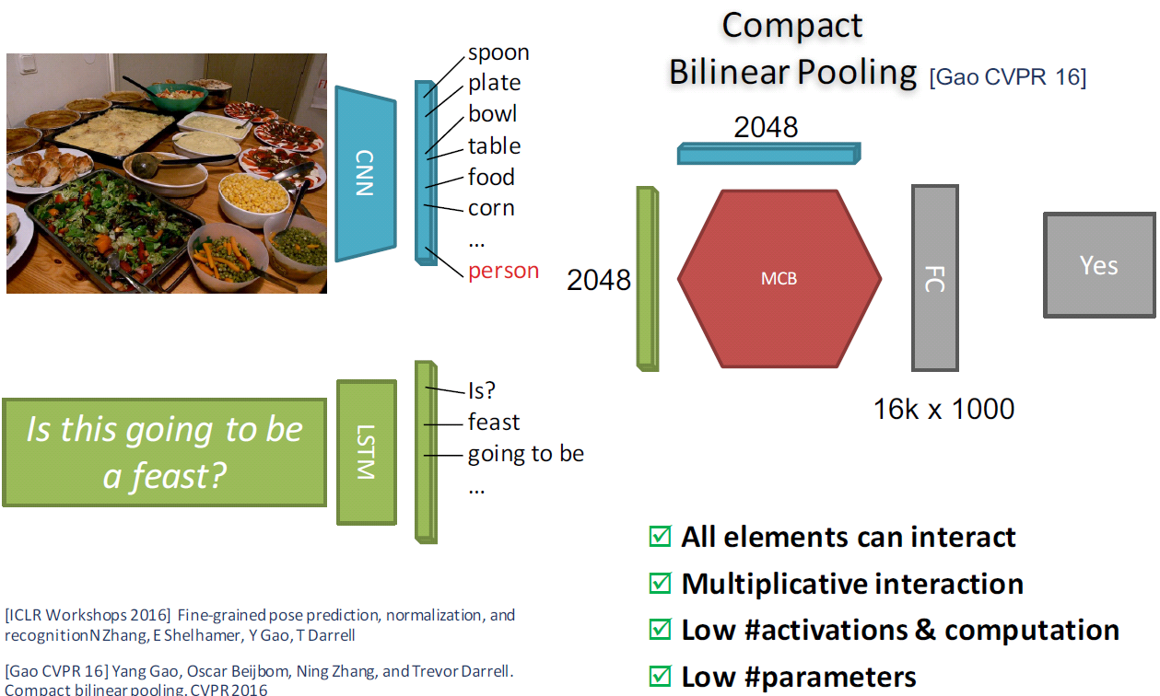
How to combine image and question?

Slide 15
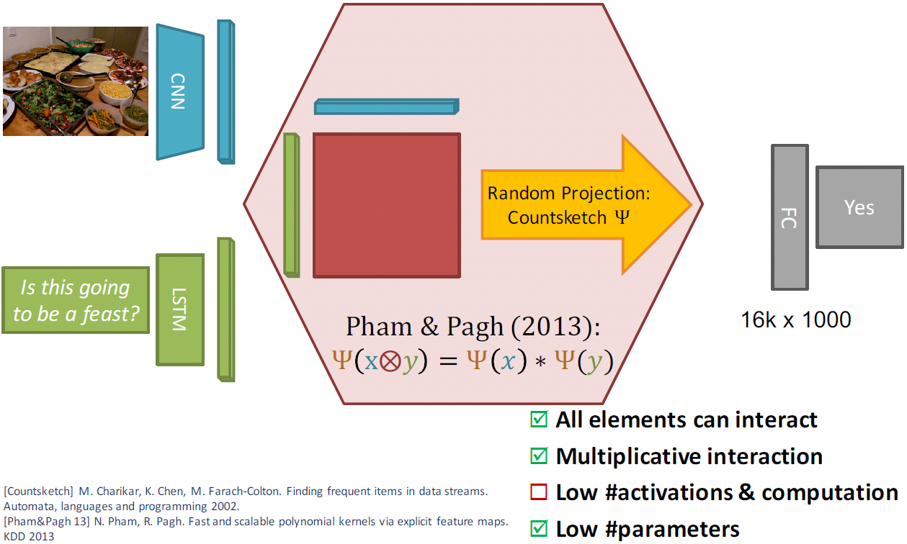
Multimodal Compact Bilinear Pooling

Slide 16
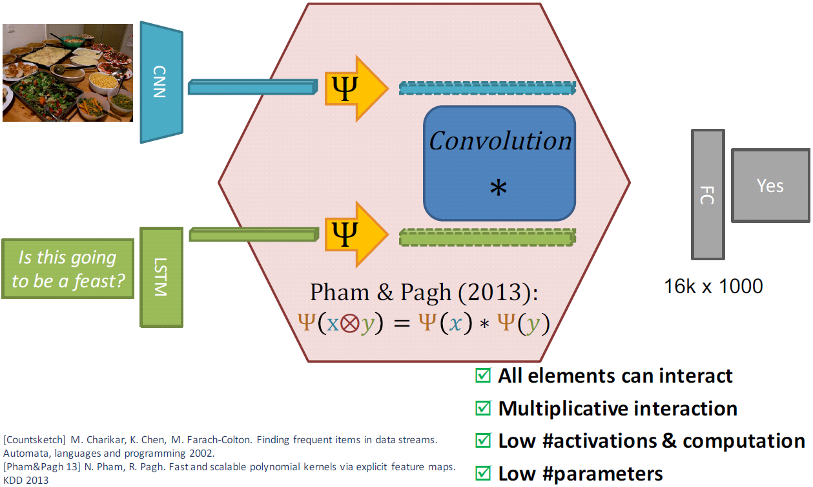
Multimodal Compact Bilinear Pooling

Slide 17
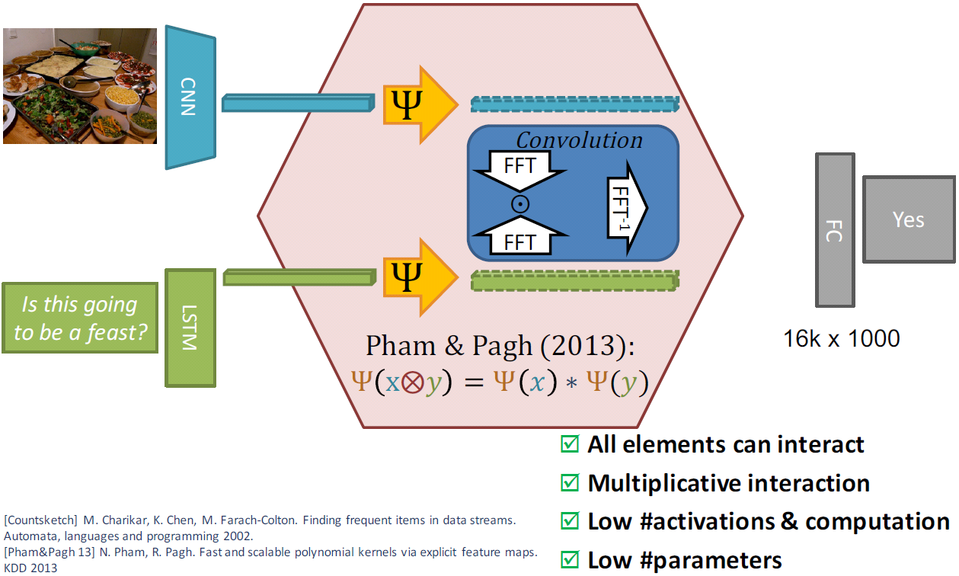
Multimodal Compact Bilinear Pooling

Slide 18
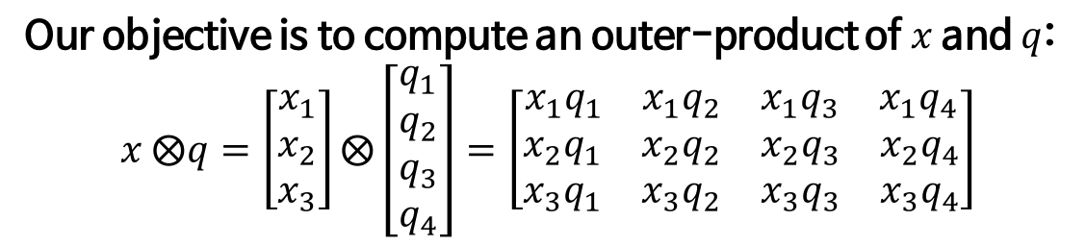

Multimodal Compact Bilinear Pooling
Our objective is to compute an outer-product of $x$ and $q$:
$$x ⨂q=\left[\begin{aligned}x_{1} \\ x_{2} \\ x_{3}\end{aligned}\right]⨂\left[\begin{aligned}q_{1} \\ q_{2} \\ q_{3} \\ q_{4}\end{aligned}\right]=\left[\begin{matrix}\begin{matrix}\begin{matrix}x_{1}q_{1} & x_{1}q_{2}\end{matrix} & \begin{matrix}x_{1}q_{3} & x_{1}q_{4}\end{matrix}\end{matrix} \\ \begin{matrix}\begin{matrix}x_{2}q_{1} & x_{2}q_{2}\end{matrix} & \begin{matrix}x_{2}q_{3} & x_{2}q_{4}\end{matrix}\end{matrix} \\ \begin{matrix}\begin{matrix}x_{3}q_{1} & x_{3}q_{2}\end{matrix} & \begin{matrix}x_{3}q_{3} & x_{3}q_{4}\end{matrix}\end{matrix}\end{matrix}\right]$$
But this matrix becomes too large if $x$ and $q$ are long vectors.
What we know is that
$$Ψ\left(x⨂q, h, s\right)=Ψ\left(x, h, s\right) ∗Ψ\left(q, h, s\right)$$
$$=FFT^{−1}\left(FFT\left(Ψ\left(x, h, s\right)\right) ⨀FFT\left(Ψ\left(q h, s\right)\right)\right)$$
where $Ψ\left(⋅\right)$ is a count sketch operation.
So, instead of using outer-product of $x$ and $q$, we will use its count sketch of outer-product!

Slide 19
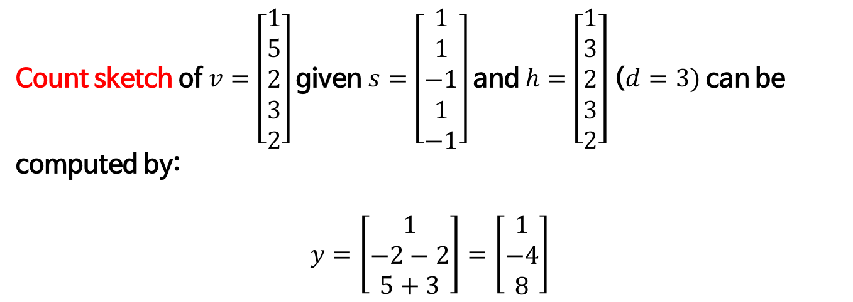
Count sketch operation
Count sketch of $v=\left[\begin{aligned}1 \\ 5 \\ 2 \\ 3 \\ 2\end{aligned}\right]$ given $s=\left[\begin{aligned}1 \\ 1 \\ −1 \\ 1 \\ −1\end{aligned}\right]$ and $h=\left[\begin{aligned}1 \\ 3 \\ 2 \\ 3 \\ 2\end{aligned}\right]$ ($d=3)$can be computed by:
$$y=\left[\begin{aligned}1 \\ −2−2 \\ 5+3\end{aligned}\right]=\left[\begin{aligned}1 \\ −4 \\ 8\end{aligned}\right]$$
Randomly initialized !

Slide 20
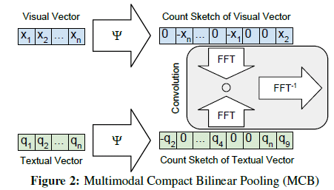
Multimodal Compact Bilinear Pooling

Slide 21
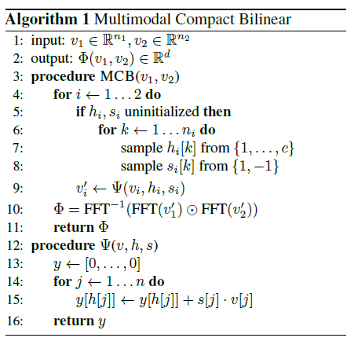
Multimodal Compact Bilinear Pooling

Slide 22
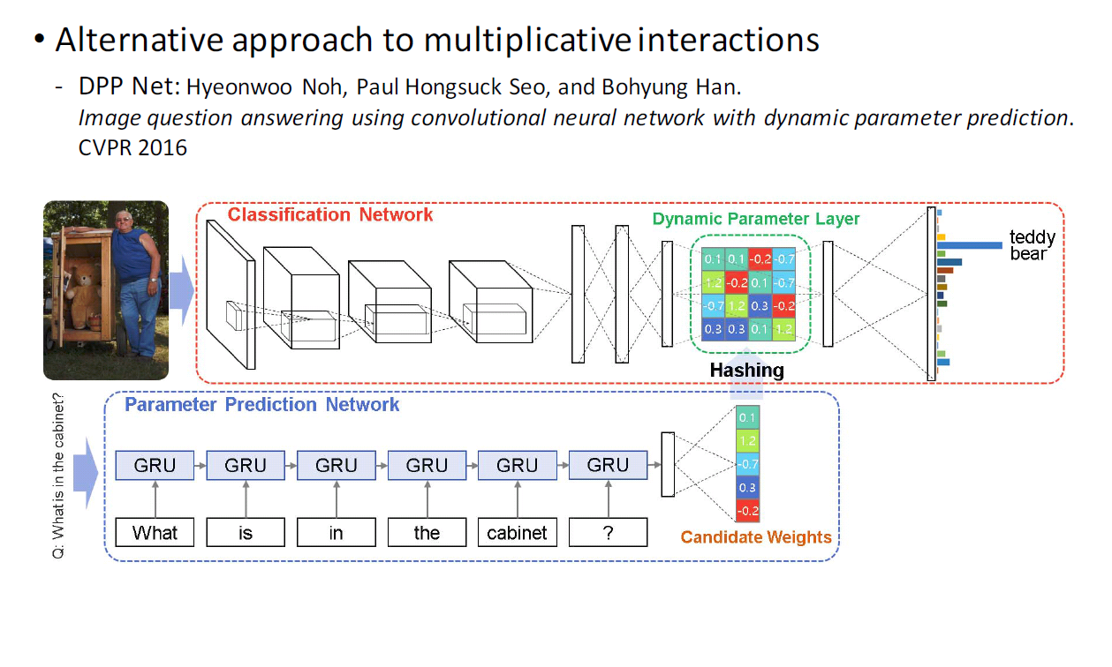
Related work

Slide 23
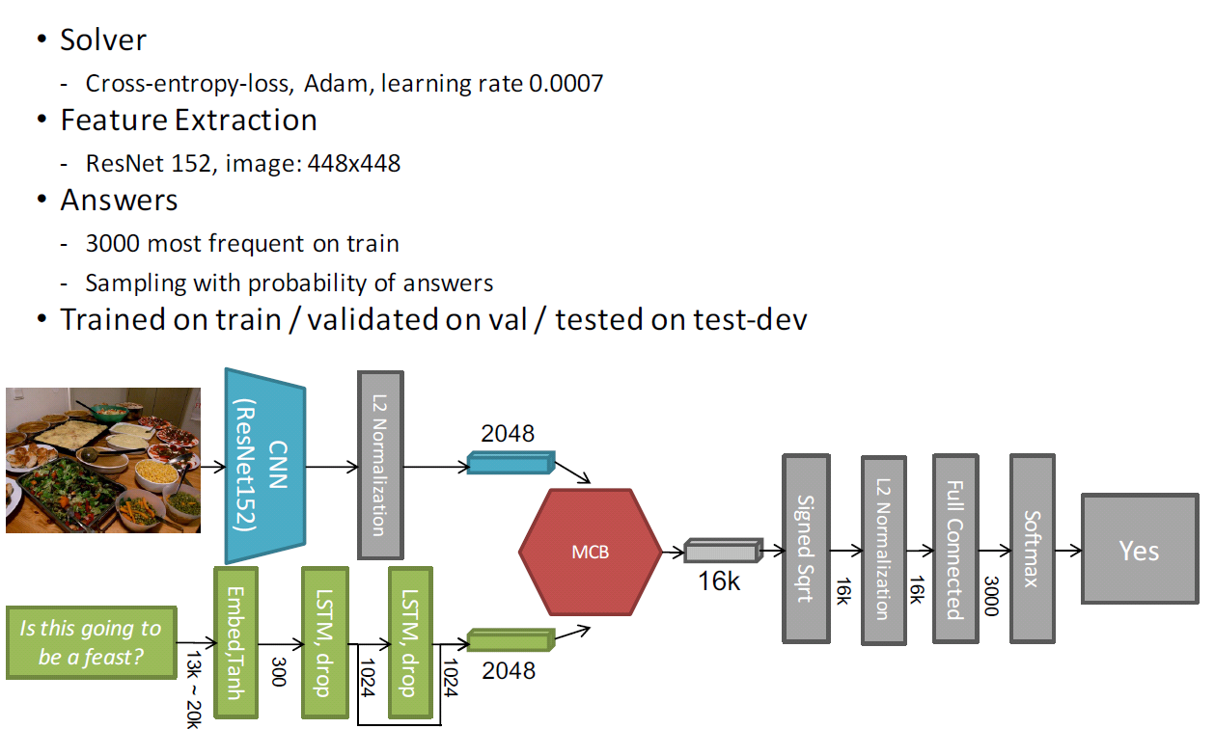
MCB without Attention

Slide 24
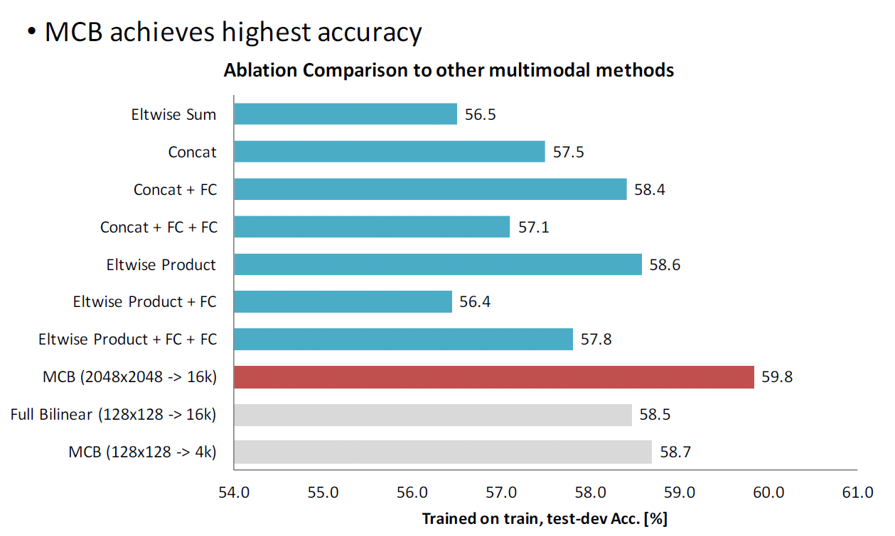
MCB without Attention

Slide 25
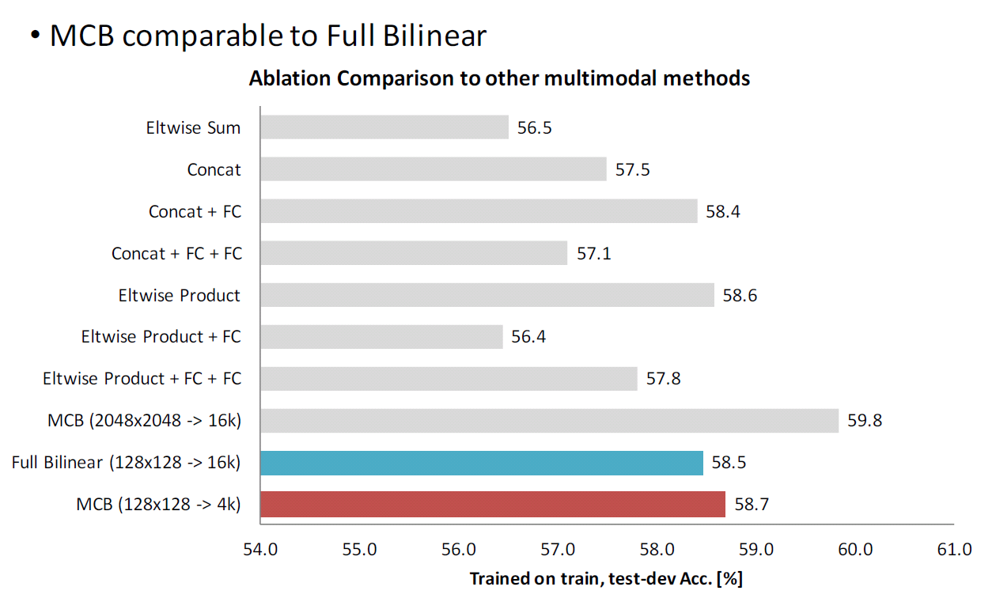
MCB without Attention

Slide 26
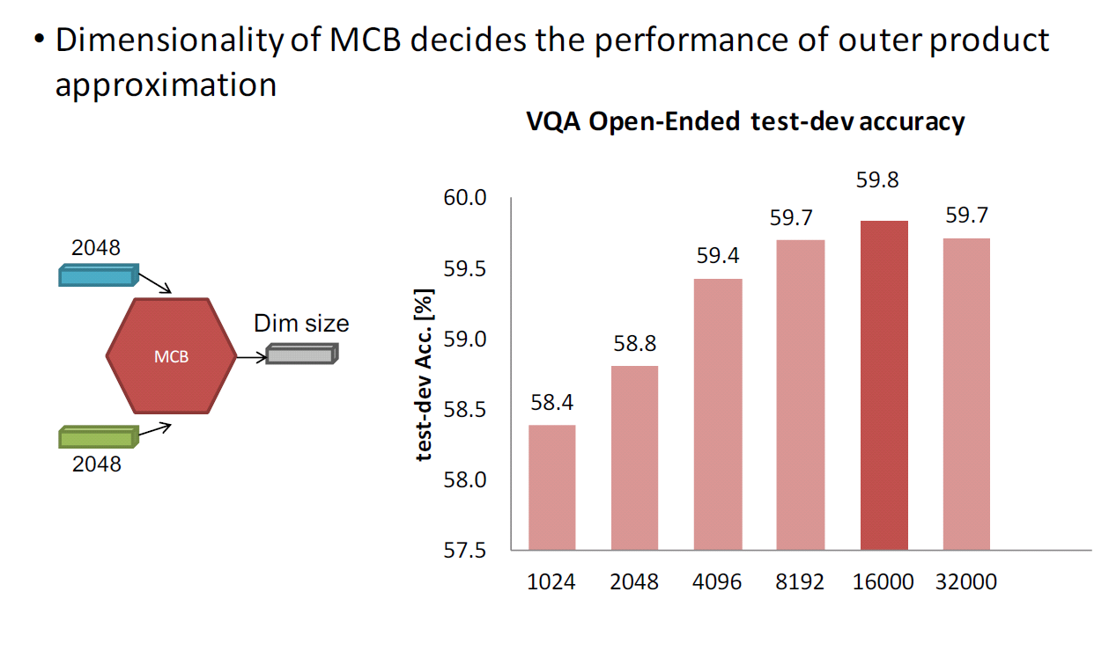
MCBP without Attention

Slide 27
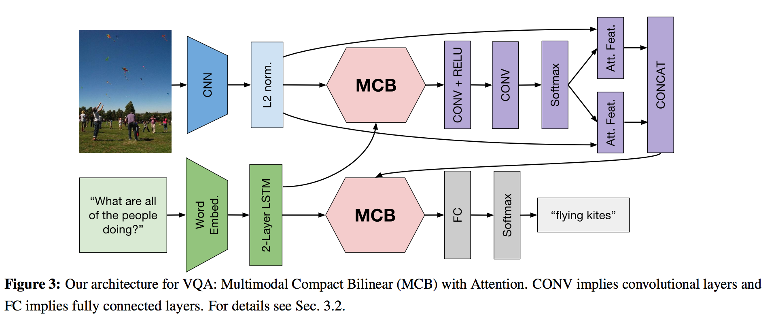
MCB with Attention

Slide 28
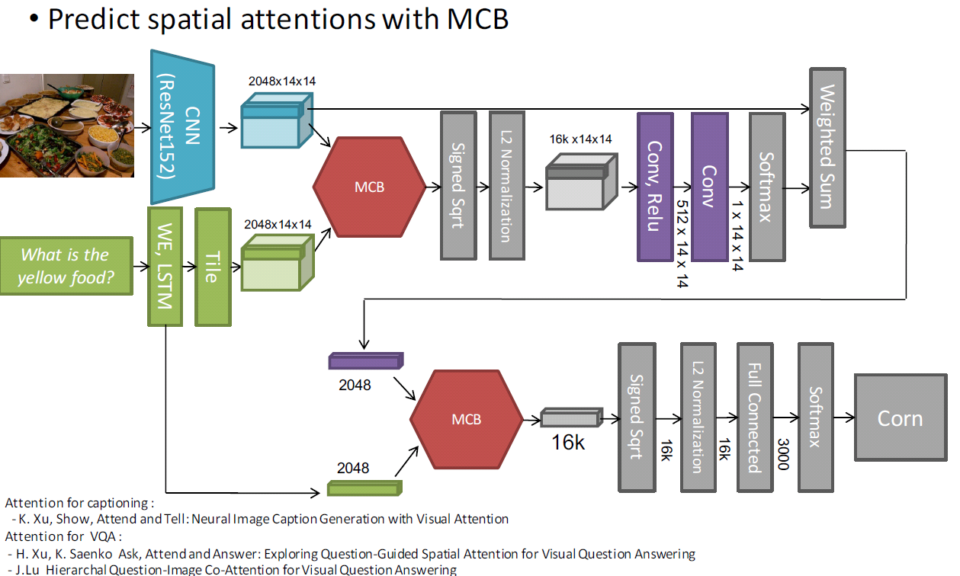
MCB with Attention
For each spatial grid location in the visual representation
we use MCB pooling to merge it with the language representation
After the pooling we use two convolutional layers to predict the attention weight for each grid location. We apply softmax to produce a normalized soft attention map.

Slide 29
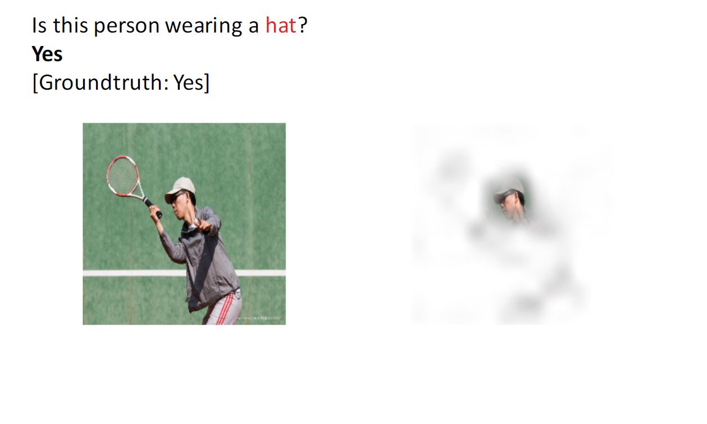
Results

Slide 30
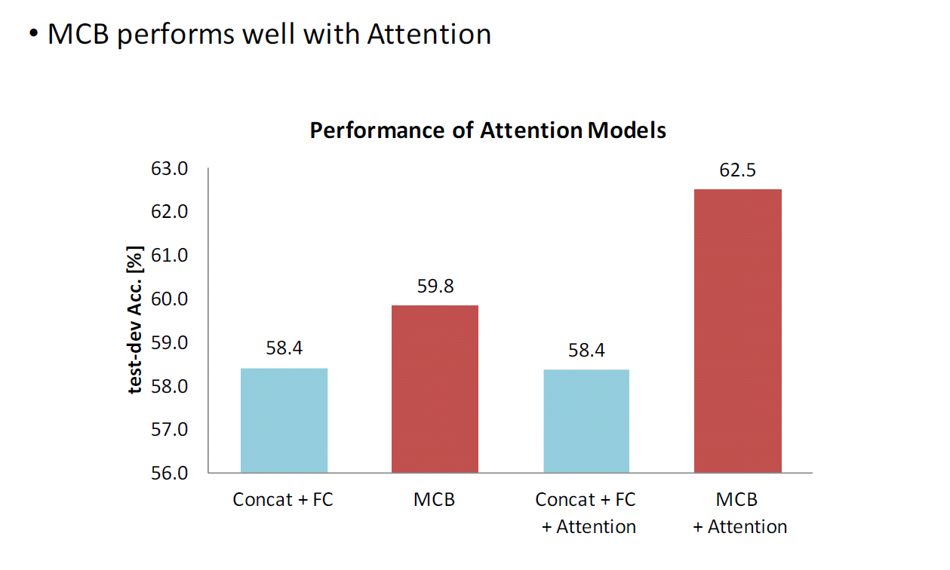
Results

Slide 31
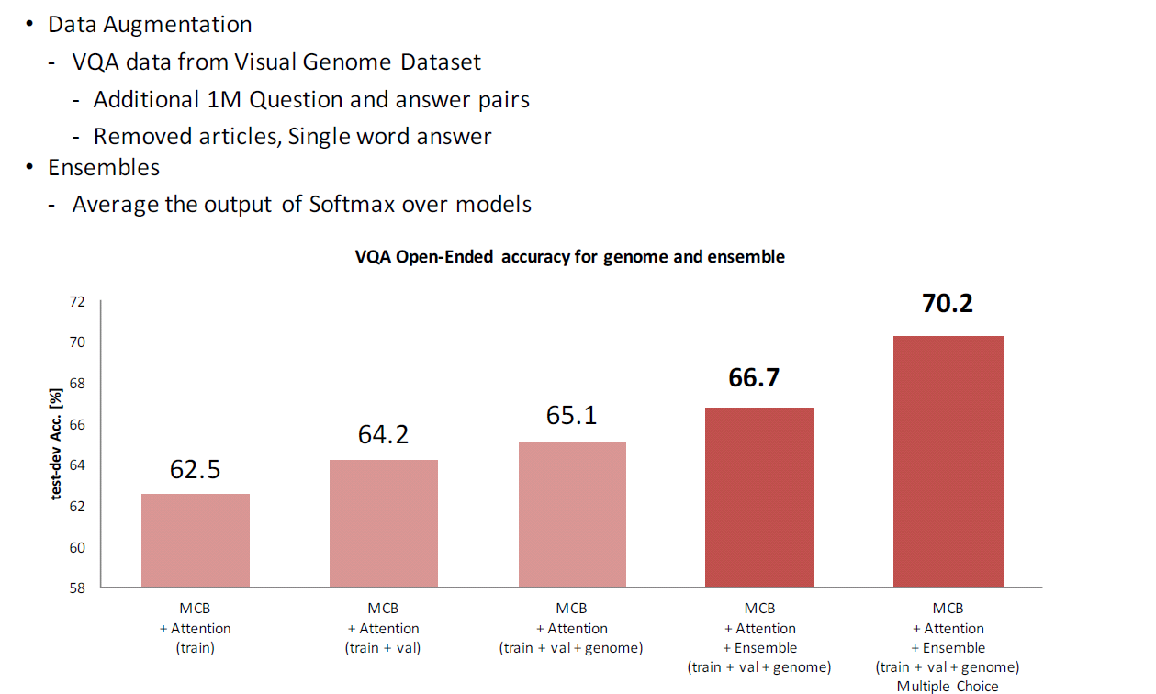
Results

Slide 32
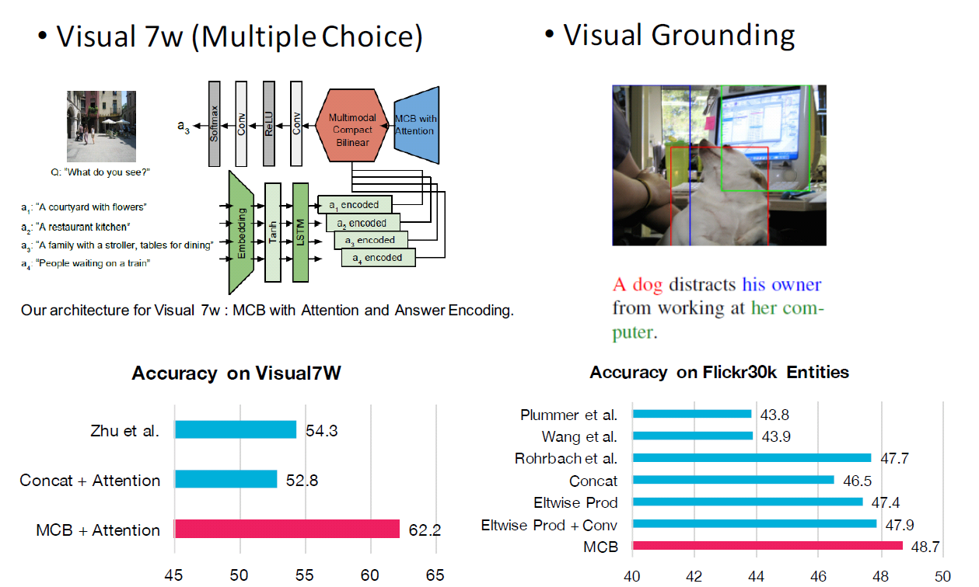
Results

Slide 33
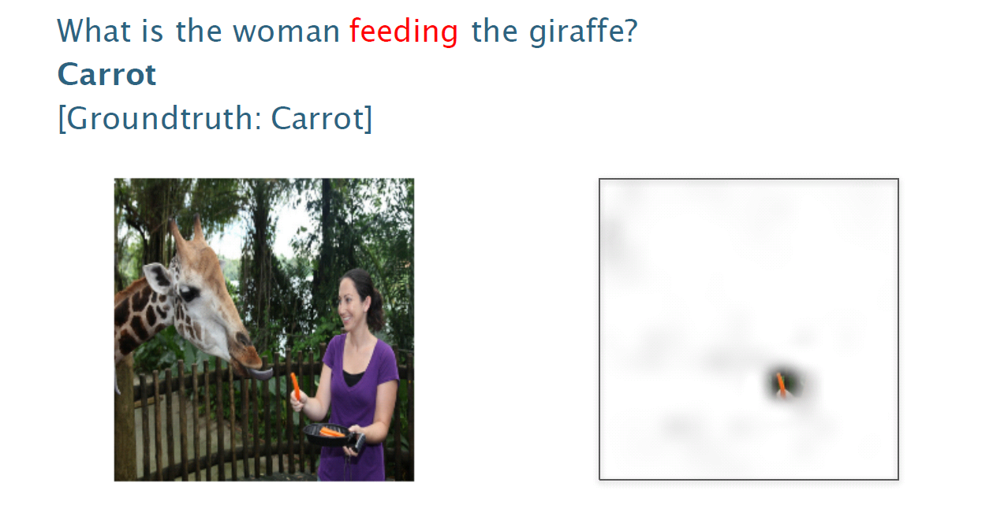
Results

Slide 34
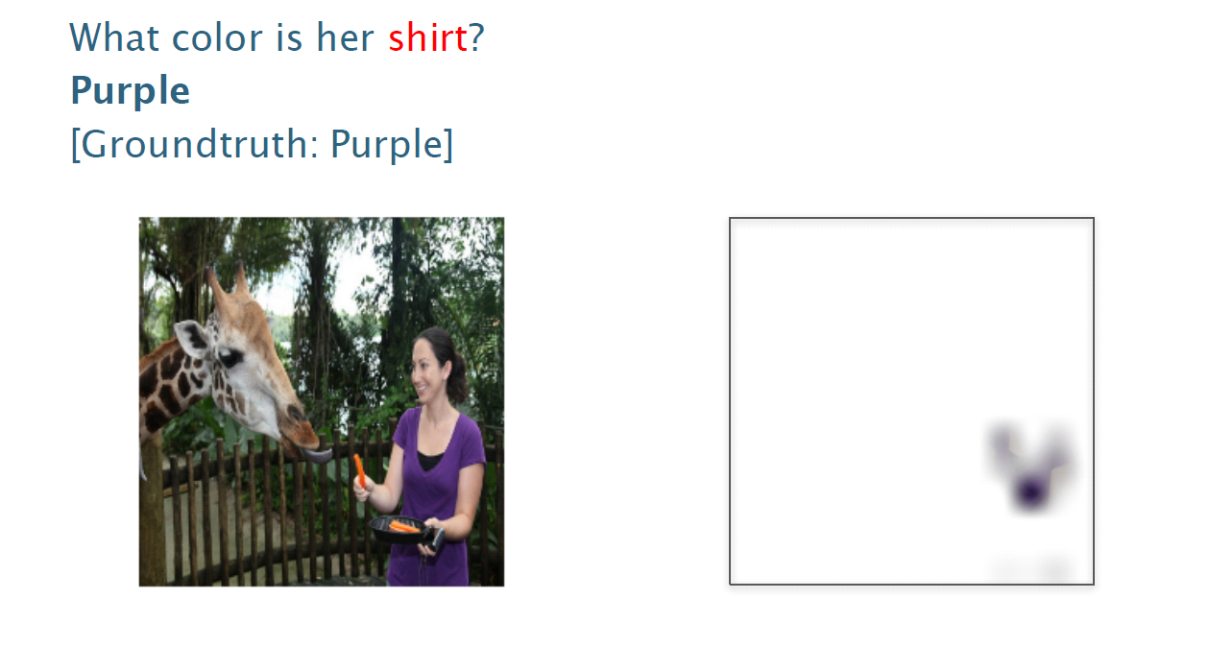
Results

Slide 35
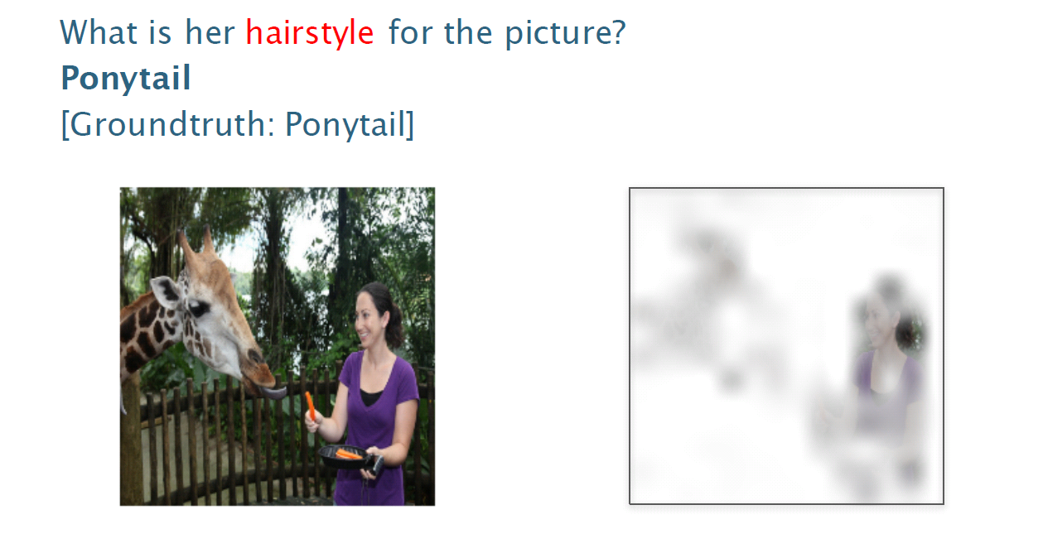
Results

Slide 36
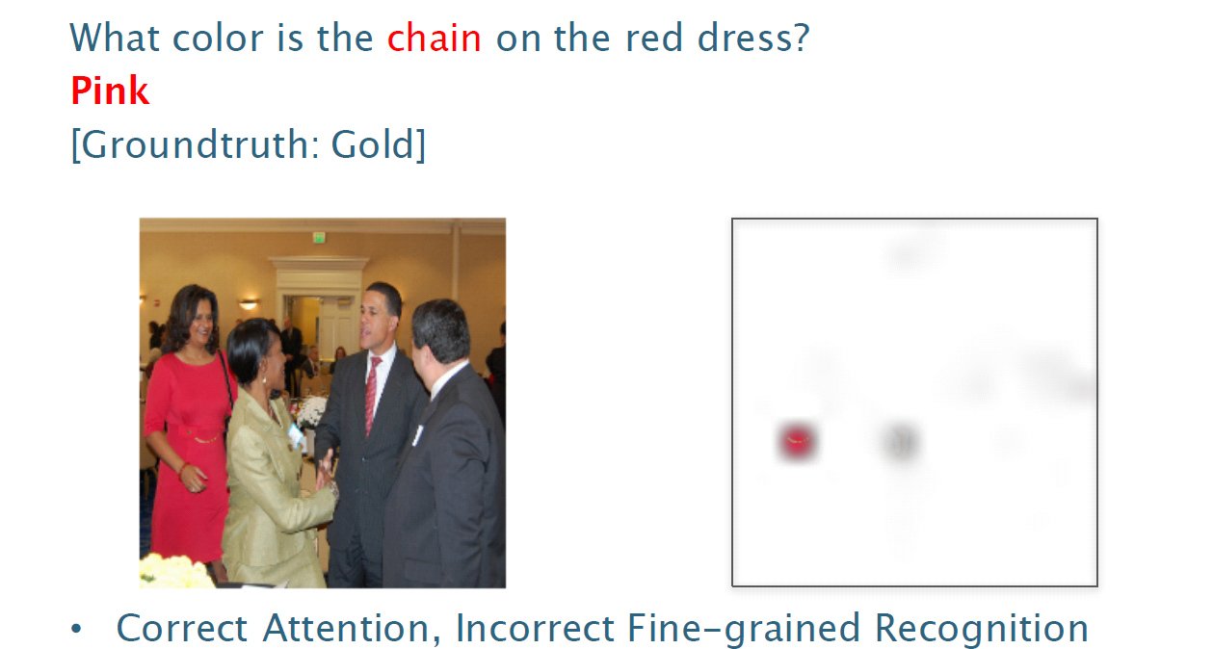
Results

Slide 37
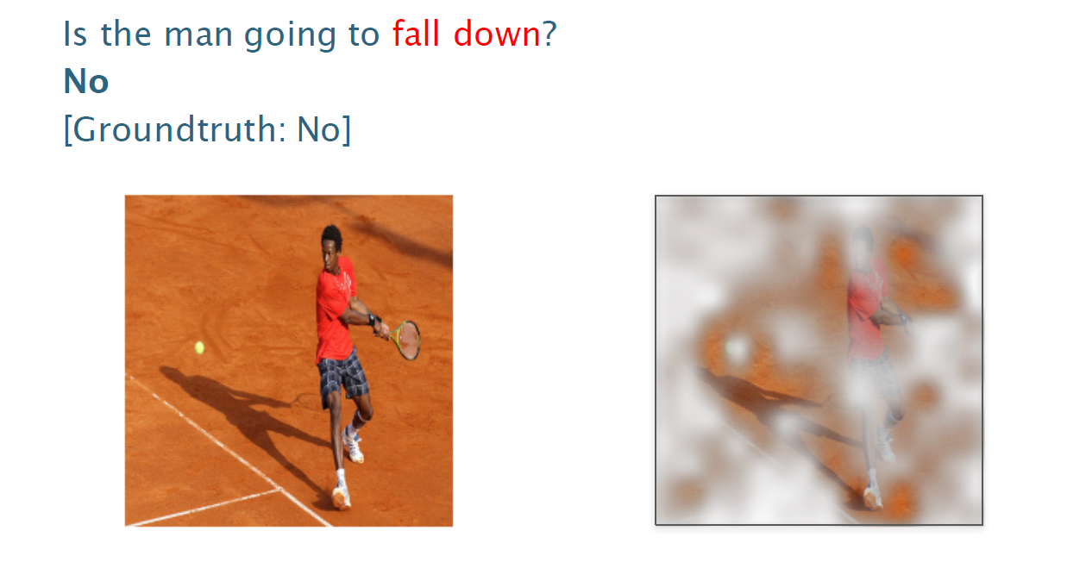
Results

Slide 38
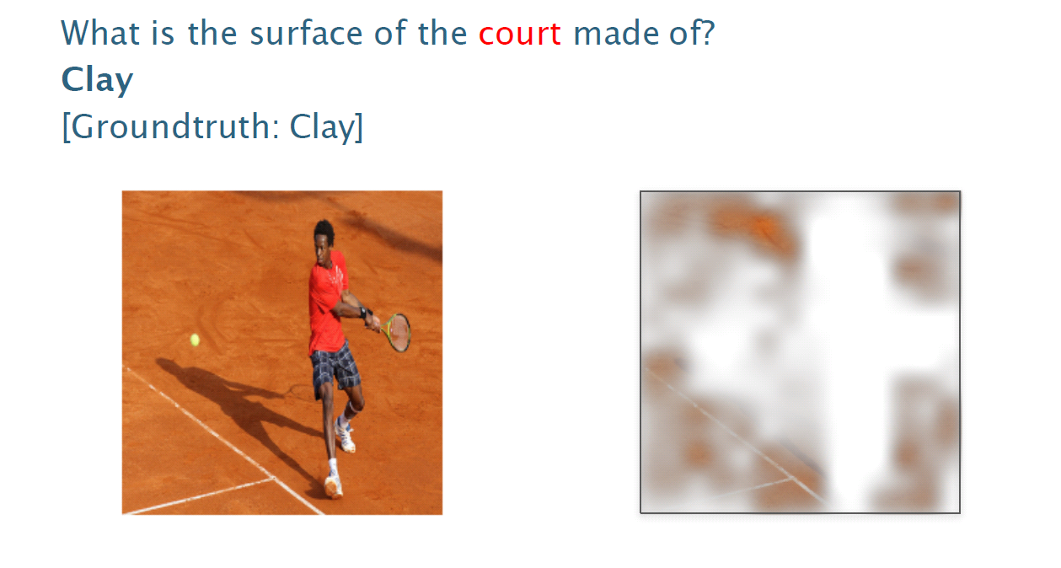
Results

Slide 39
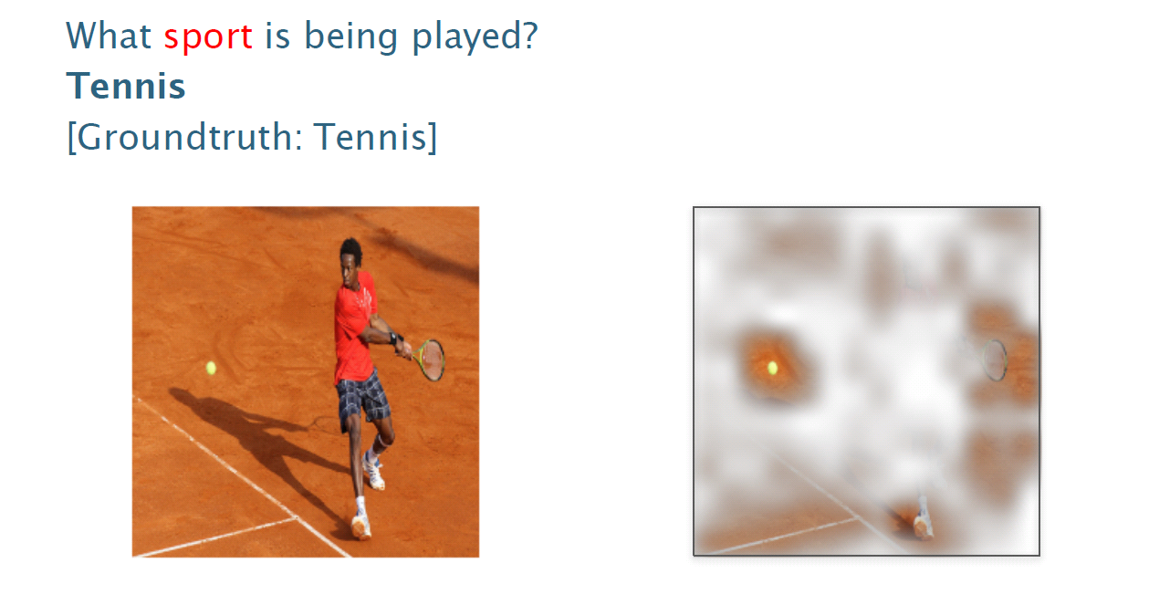
Results

Slide 40
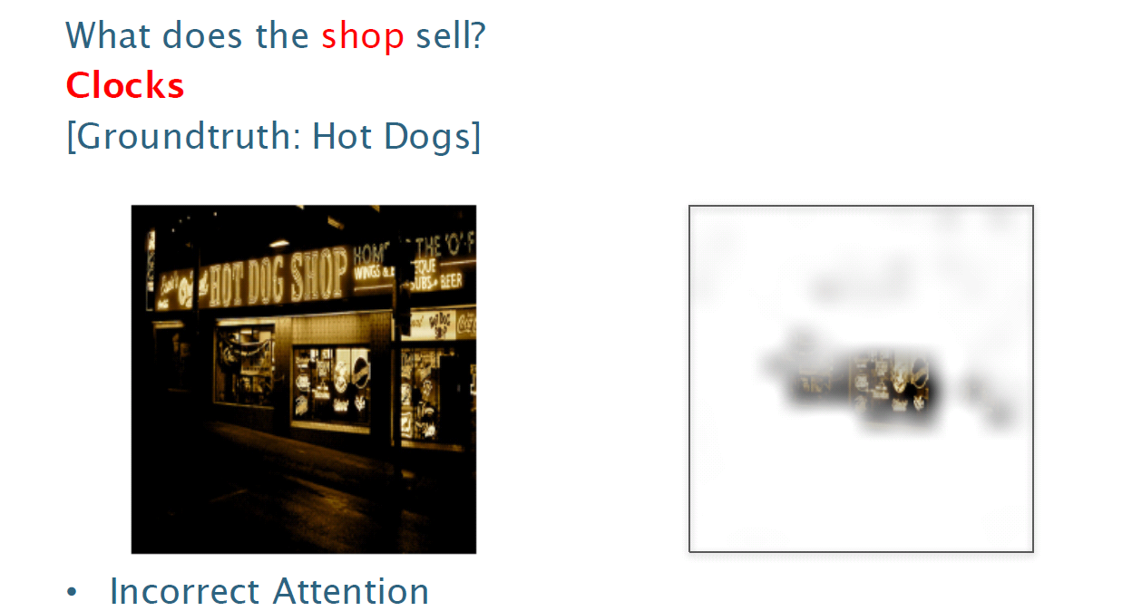
Results

Slide 41
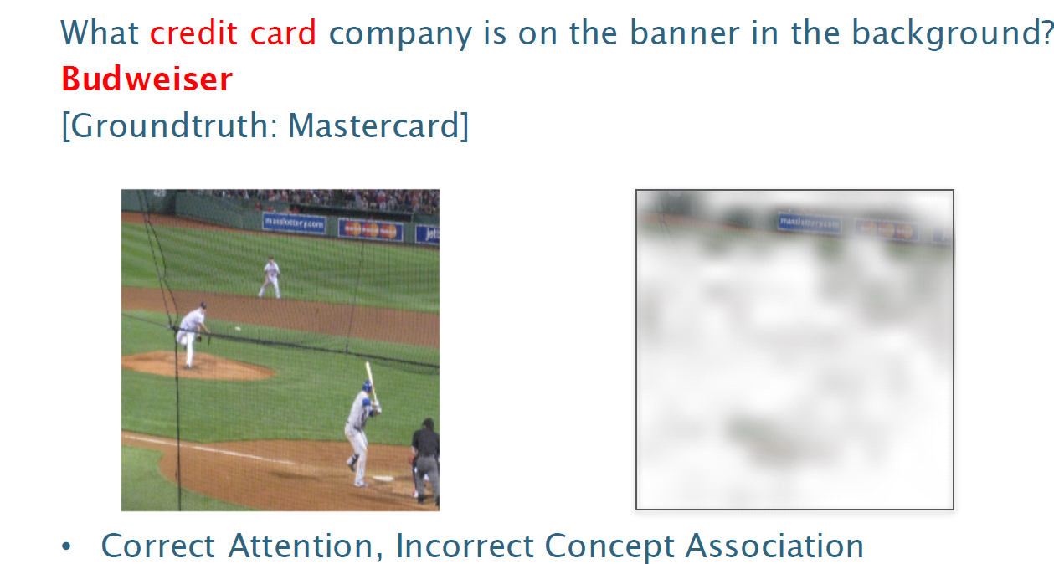
Results

Slide 42


